Slide 1

Explainable AI (XAI) for Neural Networks
Week 12, group 3

Slide 2
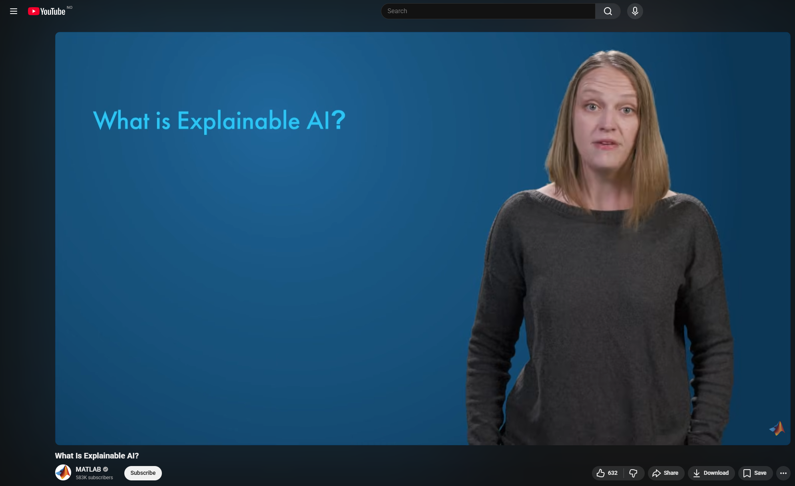
Matlab – What Is Explainable AI

Slide 3
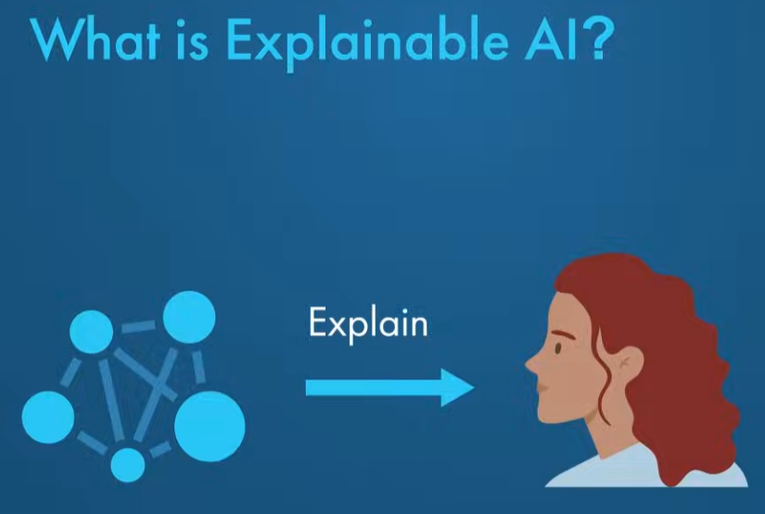

Slide 4
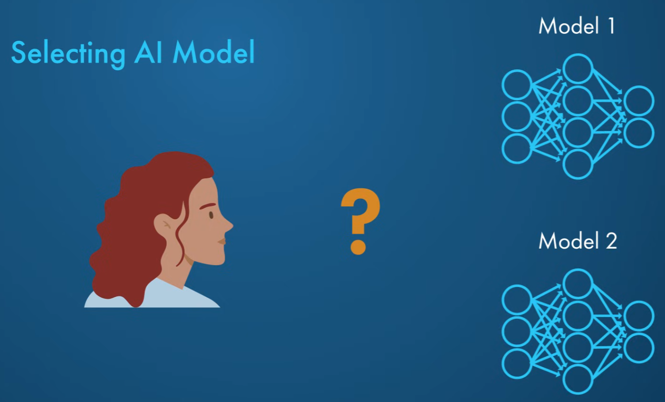

Slide 5


Slide 6
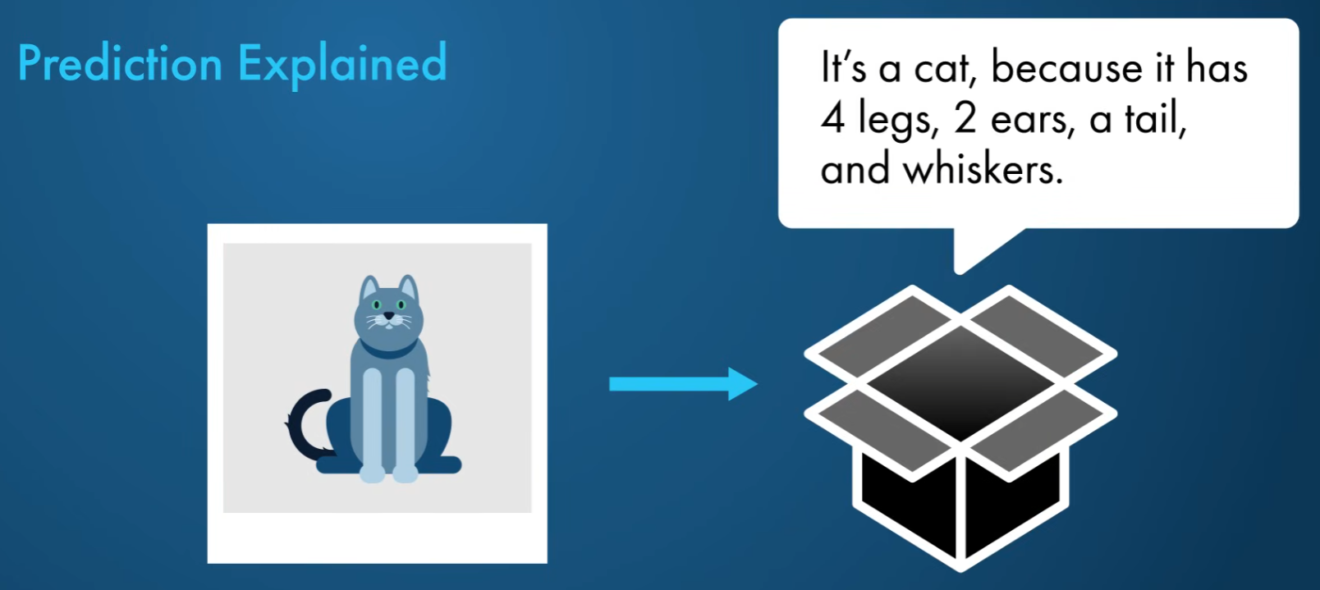

Slide 7
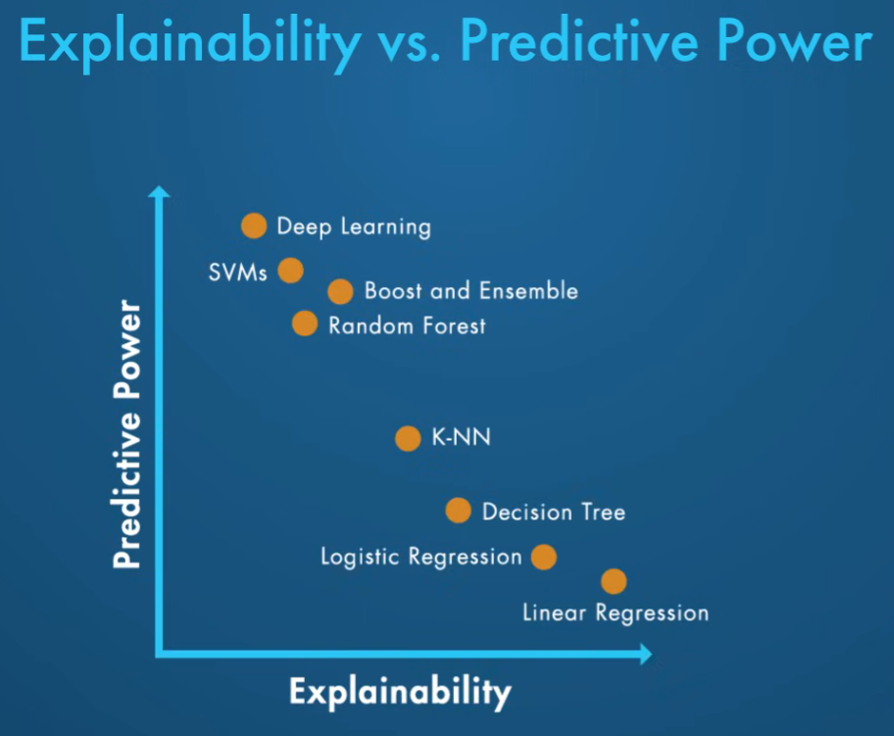

Slide 8
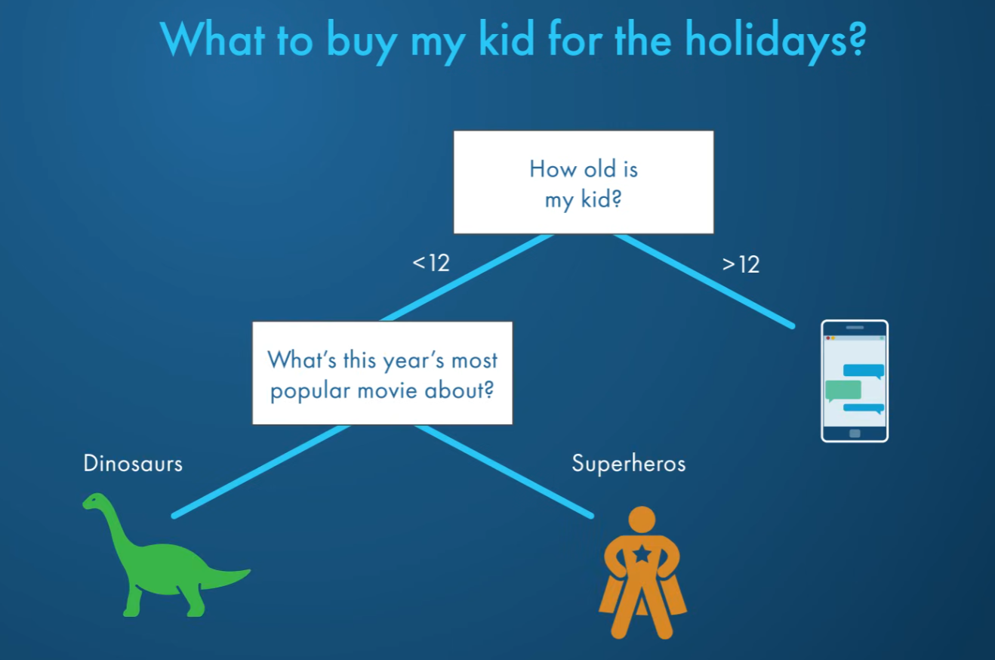

Slide 9
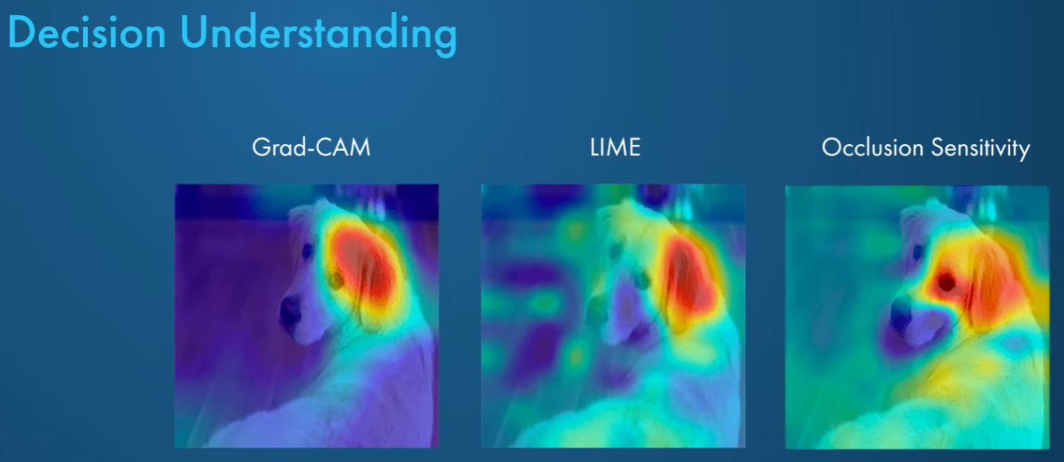

Slide 10
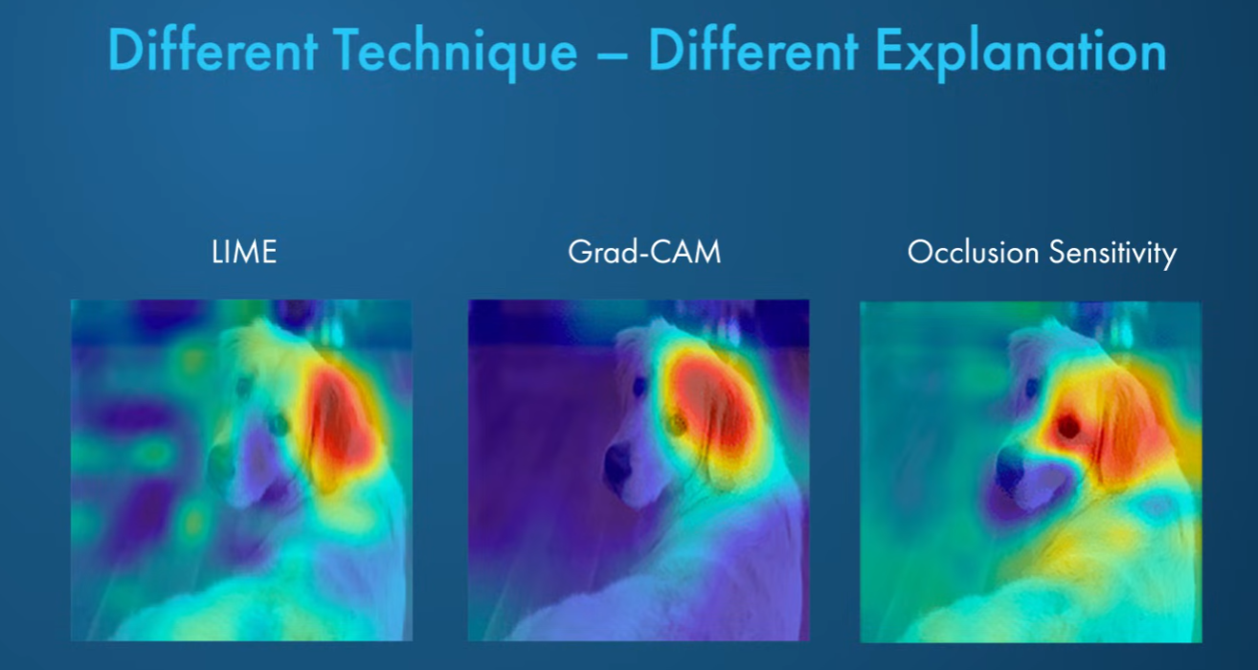

Slide 11
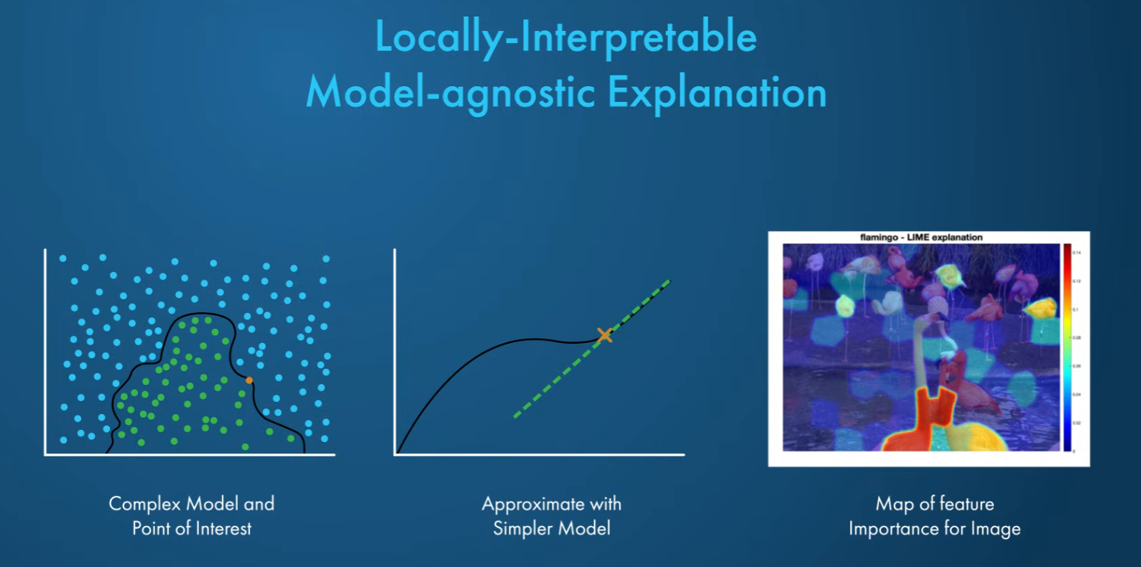

Slide 12
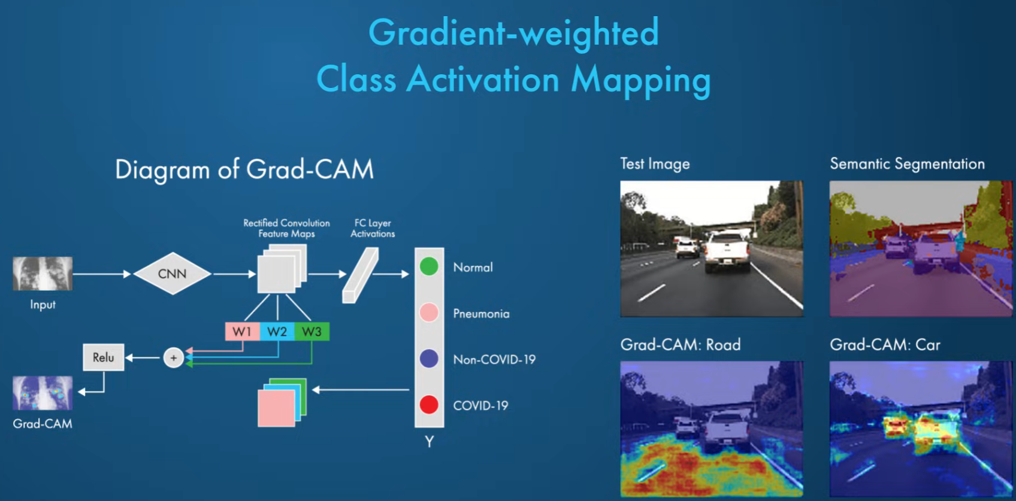

Slide 13
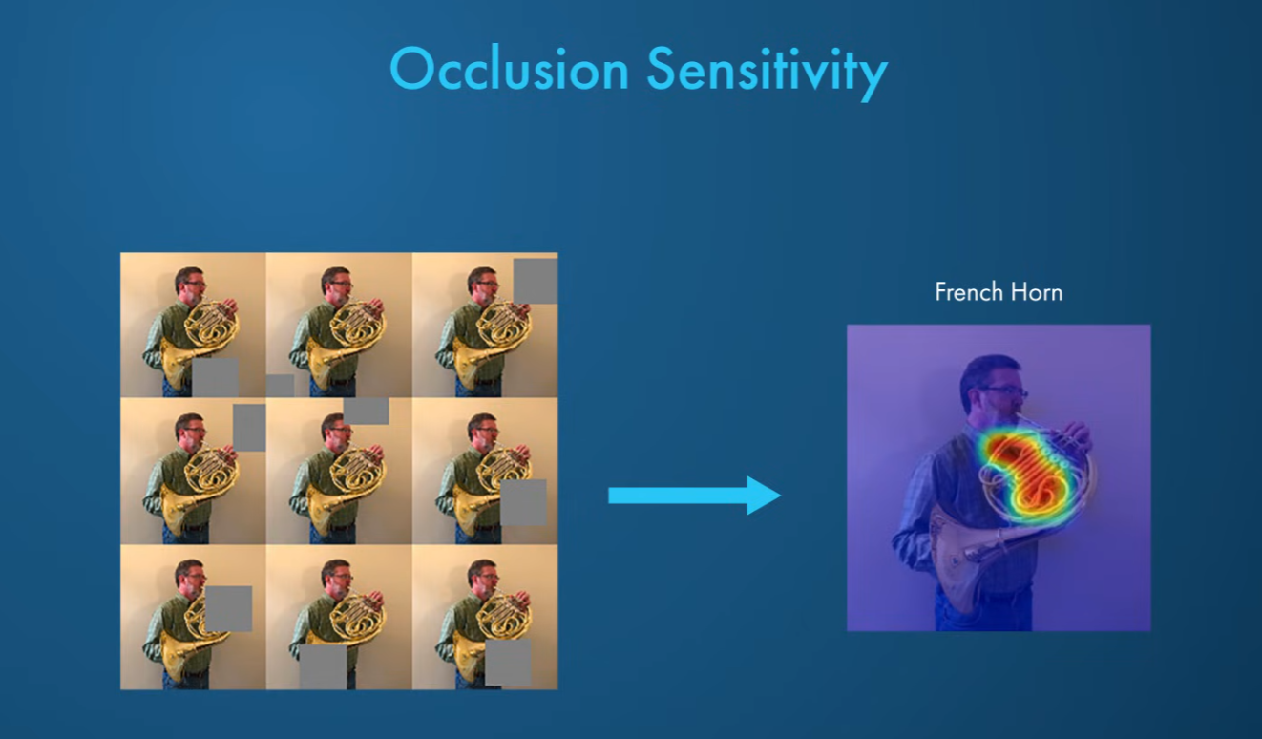

Slide 14
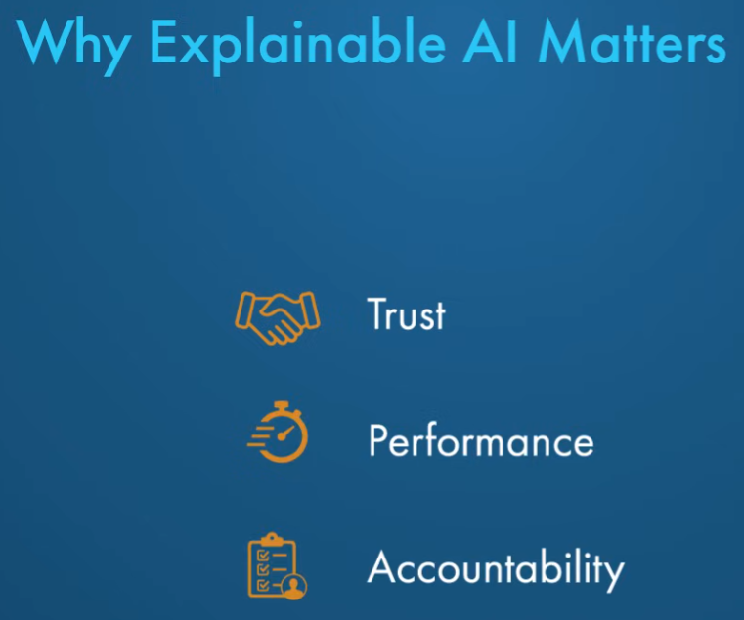

Slide 15



Slide 16
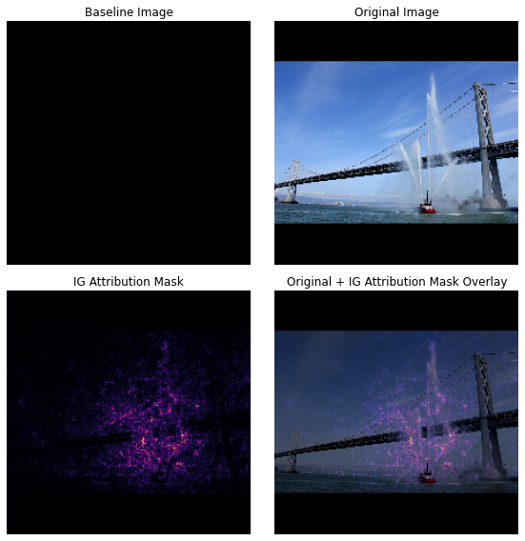
Integrated Gradients
Axioms:
Sensitivity: Features that change the output should get non-zero attribution.
Implementation Invariance: Functionally identical models must give identical attributions.
Method:
Start from a baseline input representing “no signal.”
Move along a straight-line path from baseline → input.
Integrate gradients of the model along this path to measure each feature’s contribution.
Properties:
Completeness: Attributions sum to F(x)−F(baseline).
Implementation-agnostic: Works for any differentiable model.
Why it matters:
Produces intuitive, stable, theoretically justified explanations for deep models.
https://colab.research.google.com/drive/1V-WpjVK9Ira5wkXIOu4bEAtGRS8RT_GX?usp=sharing#scrollTo=NG17_Wp6ikKf

Slide 17
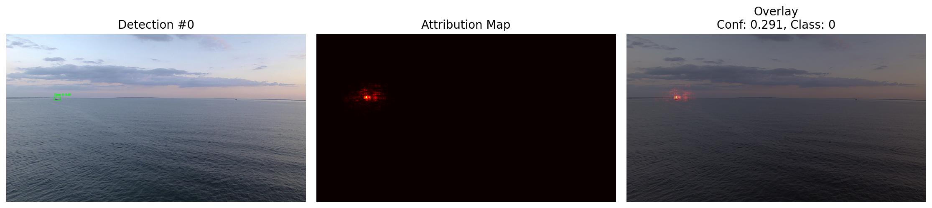
XAI for reliable ship detection

Slide 18
XAI for reliable ship detection

Slide 19
XAI for reliable ship detection

Slide 20
XAI for reliable ship detection

Slide 21
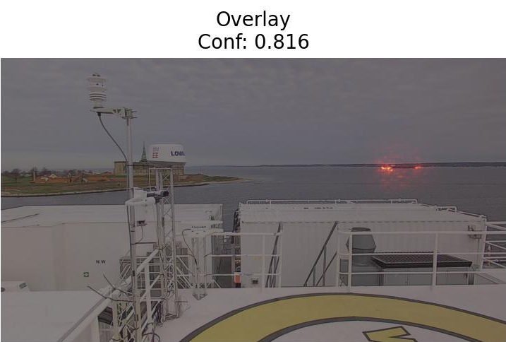
XAI for reliable ship detection

Slide 22
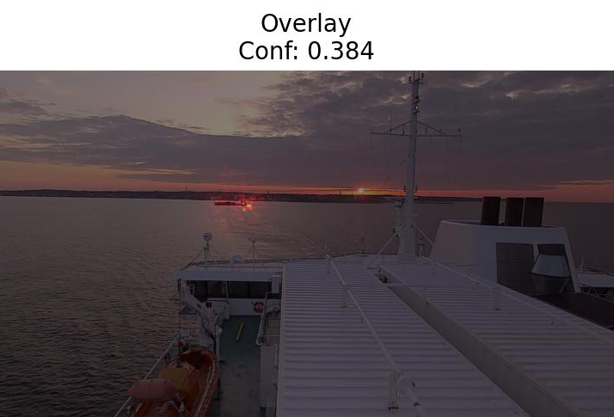
XAI for reliable ship detection

Slide 23
Quick recap
Benefits
Drawbacks
Model trust
Builds understanding
Knowledge dissemination
Implementation cost
Inherent trade-off
Over-reliance
New research

Slide 24
Thank you for your attention!

